Slide 1
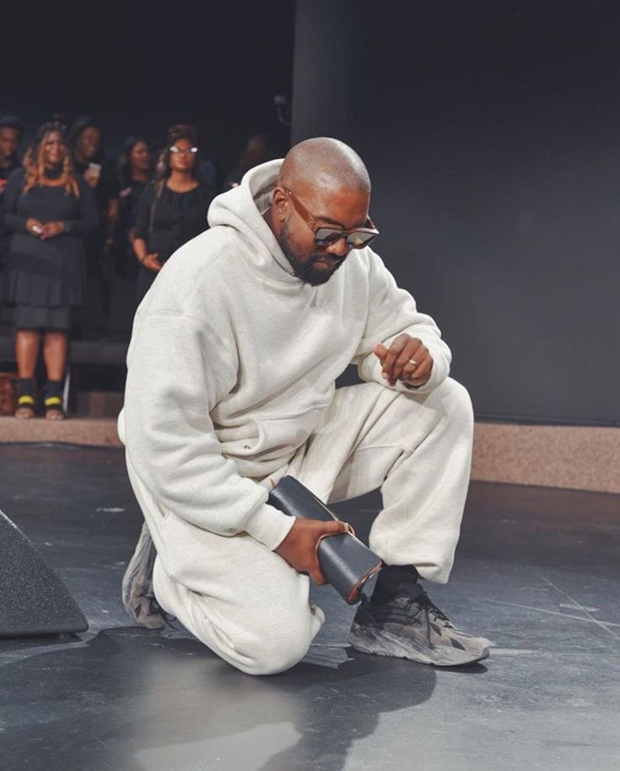
Yo, we at war We at war with terrorism, racism, And most of all, we at war with ourselves Jesus walks God show me the way because the devil's tryna break me down Jesus walks with me

Slide 4
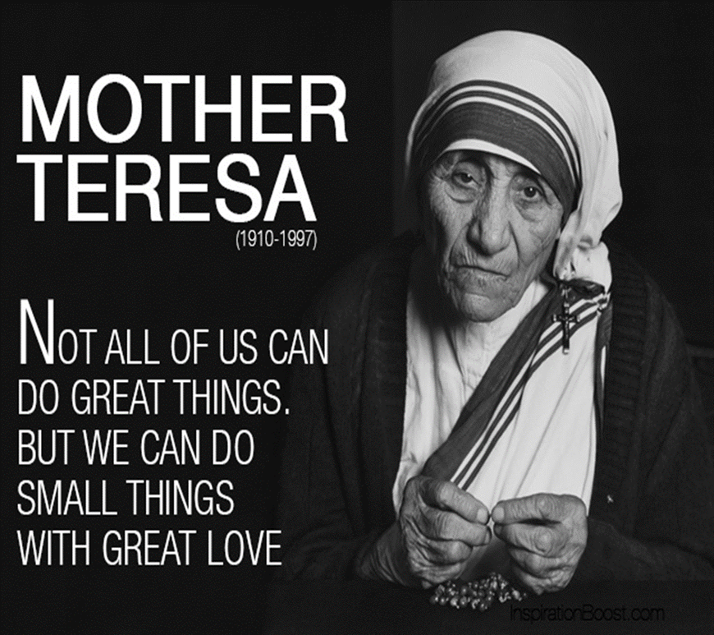

Slide 5
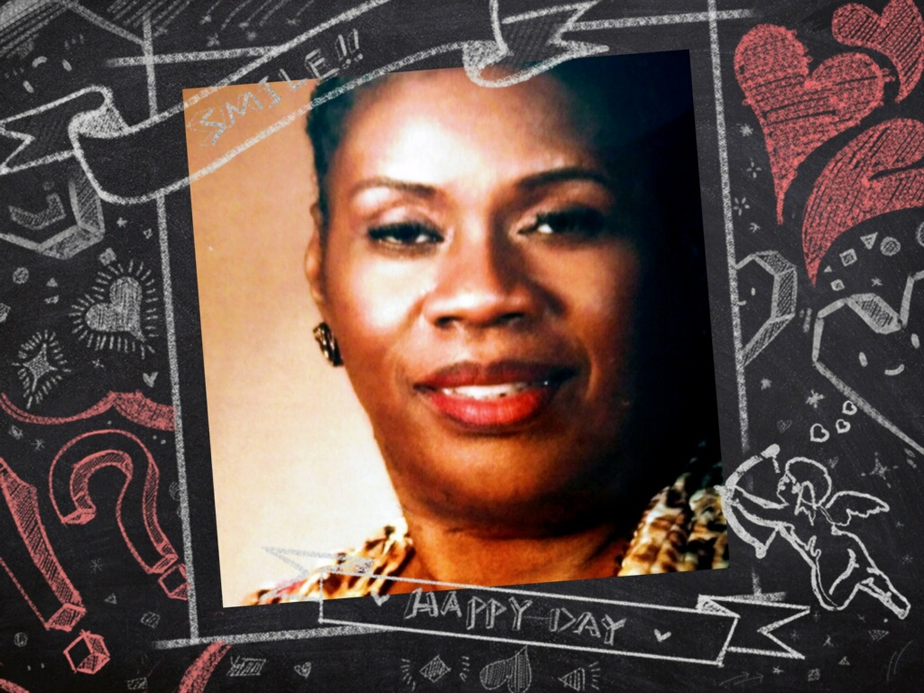
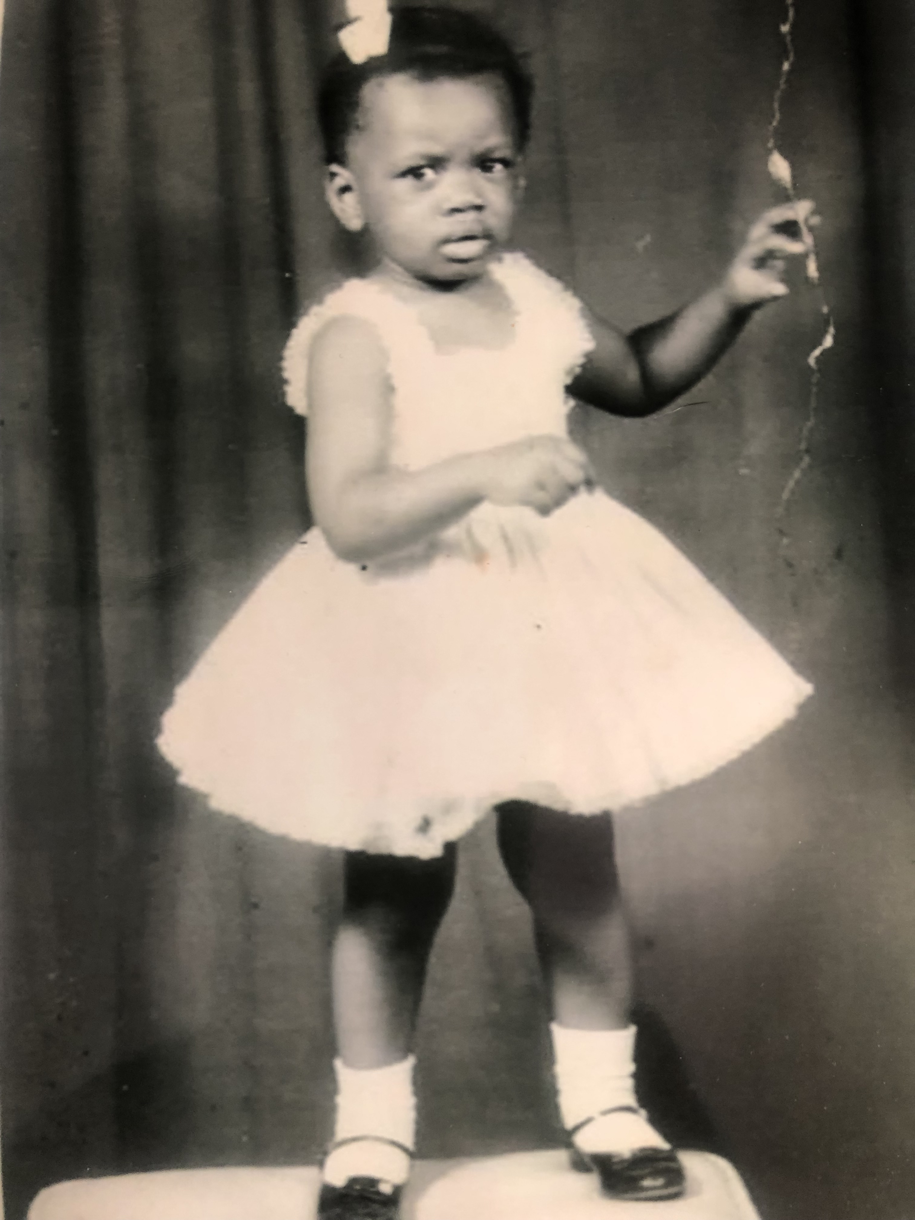
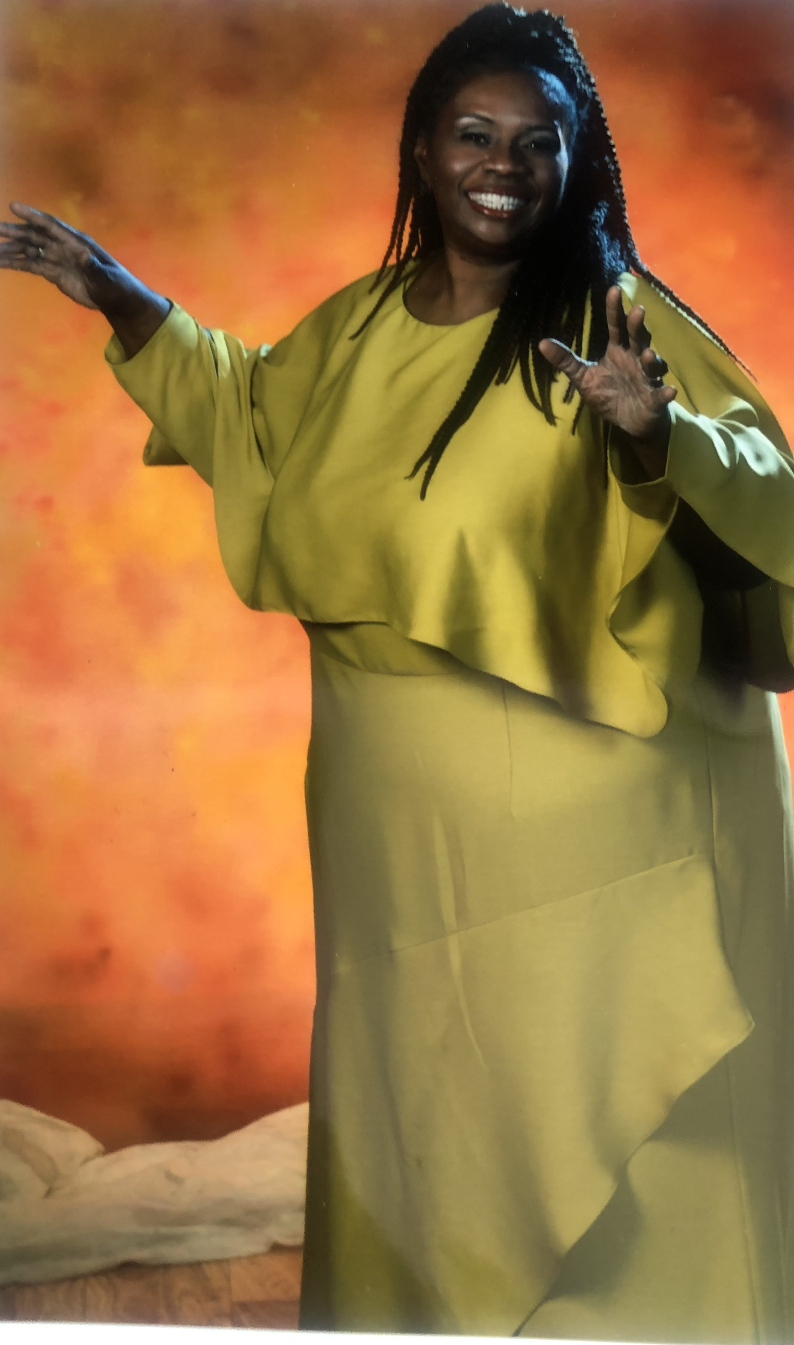
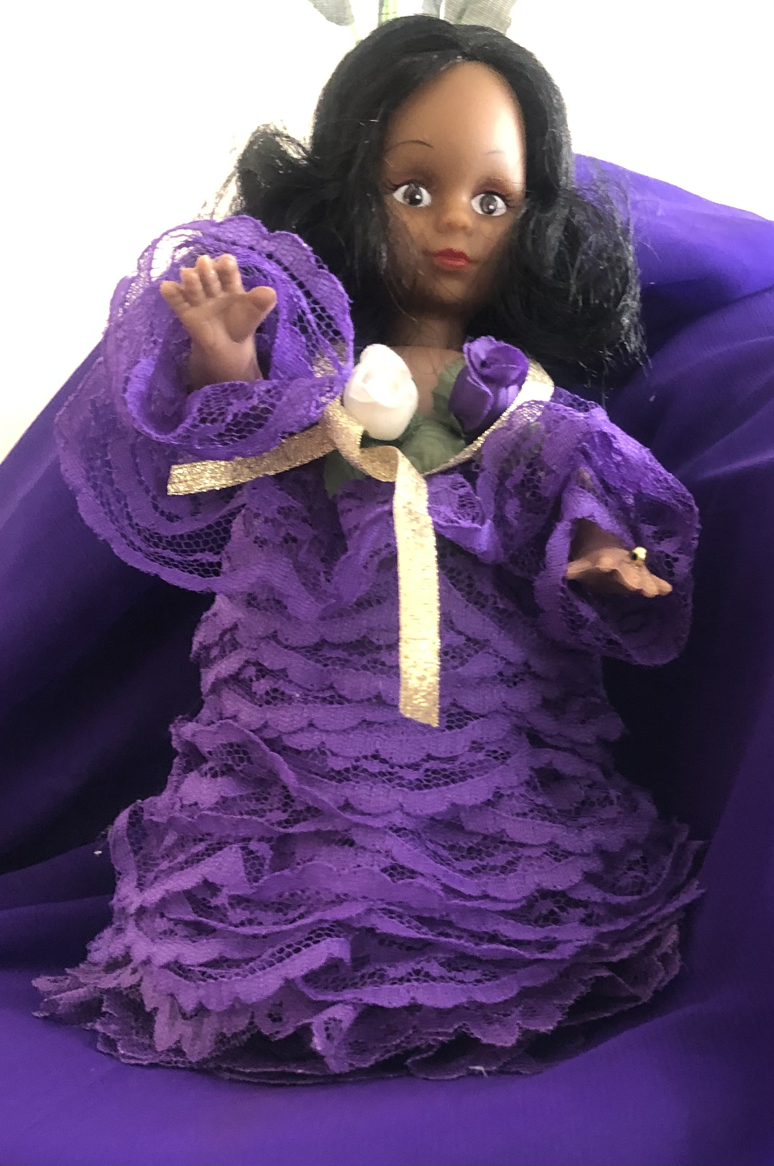
Artwork by
Sis. Juanita Edwards
Doll by Sis. Hill

Slide 7
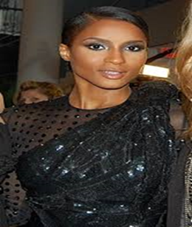
I just keep elevating,
no losses, just upgrading
My lessons, made blessings,
Level up…. Cierra
I’m gonna, Praise him,
Praise him til I’m gone. When the praise go up, the blessings come down
Blessings
Chance the Rapper

Slide 8
Rejoice in the inheritance….. 1 Peter 1: 3-4 ³ Blessed be the God and Father of our Lord Jesus Christ, which according to his abundant mercy hath begotten us again unto a lively hope by the resurrection of Jesus Christ from the dead, ⁴ To an inheritance incorruptible, and undefiled, and that fadeth not away, reserved in heaven for you,
2 Cor. 4:16-18
¹⁶ For which cause we faint not; but though our outward man perish, yet the inward man is renewed day by day.
¹⁷ For our light affliction, which is but for a moment, worketh for us a far more exceeding and eternal weight of glory;
¹⁸ While we look not at the things which are seen, but at the things which are not seen: for the things which are seen are temporal; but the things which are not seen are eternal.
This Photo by Unknown Author is licensed under CC BY-NC

Slide 9
A view from the Phoenix Perspective
YouTube Phoenix Channel
https://www.youtube.com/c/PhoenixZone7
Whispers to the Soul – A Collection of Quintessential Verse
https://a.co/d/4t7lWhw
Dr. Ruth Bentley – Wheaton College
https://www.wheaton.edu/magazine/winter-2023/dr-ruth-lewis-bentley-alumna-of-the-year/

